Slide 1


IT’s Emergency Patient: Wi-Fi Protected Access II
Su Latt Phone

Slide 2

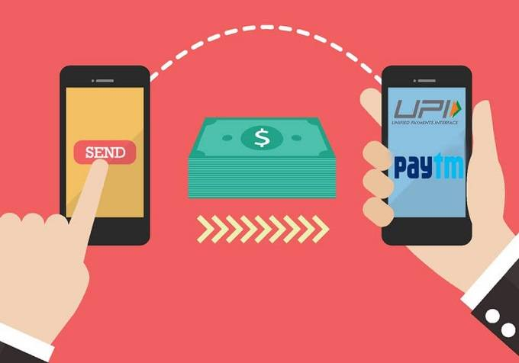
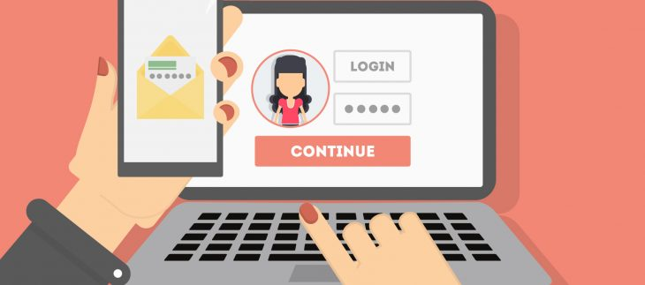


Slide 3
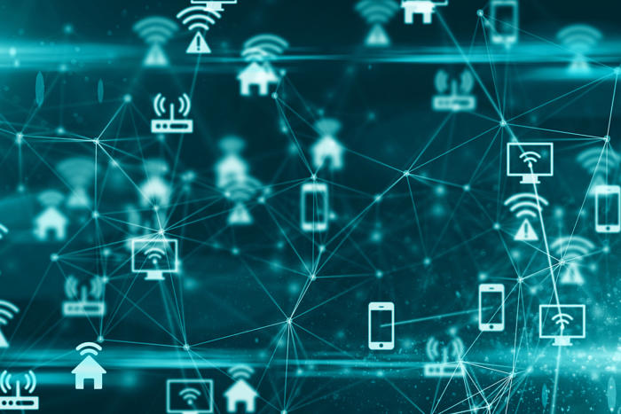

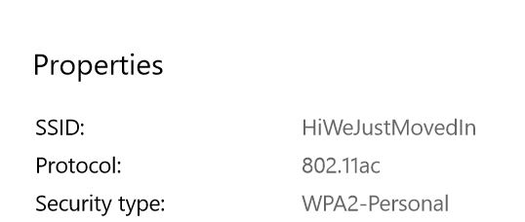
WEP
WPA
WPA2
Wired Equivalent Privacy
Wi-Fi Protected Access
4-Way Handshake
To establish secure network connection

Slide 4
WPA 2 and the 4-way Handshake
Client
Server
PTK – Pairwise Transient Key
1
Information
Generate PTK
2
Information
Generate PTK
Nonce – A number to be used only once
3
Another Key
4
Confirmation
Install PTK
Install PTK
Encrypted¹ Data
Encrypted² Data

Slide 5
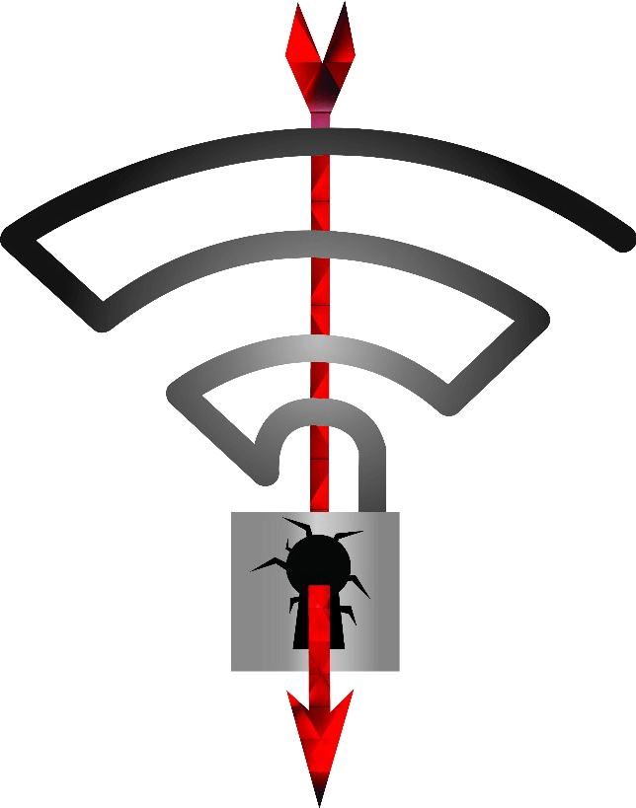
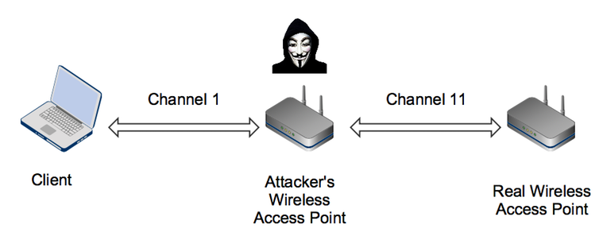
KRACK on 4-way Handshake
Client
Server
Attacker
1
Information
Generate PTK
2
Information
Generate PTK
3
Another Key
4
Confirmation
Installs PTK
Encrypted¹ Data
2
3
3
GTK
4
Confirmation
Reinstalls PTK
Installs PTK
Encrypted¹ Data
2
3

Slide 6

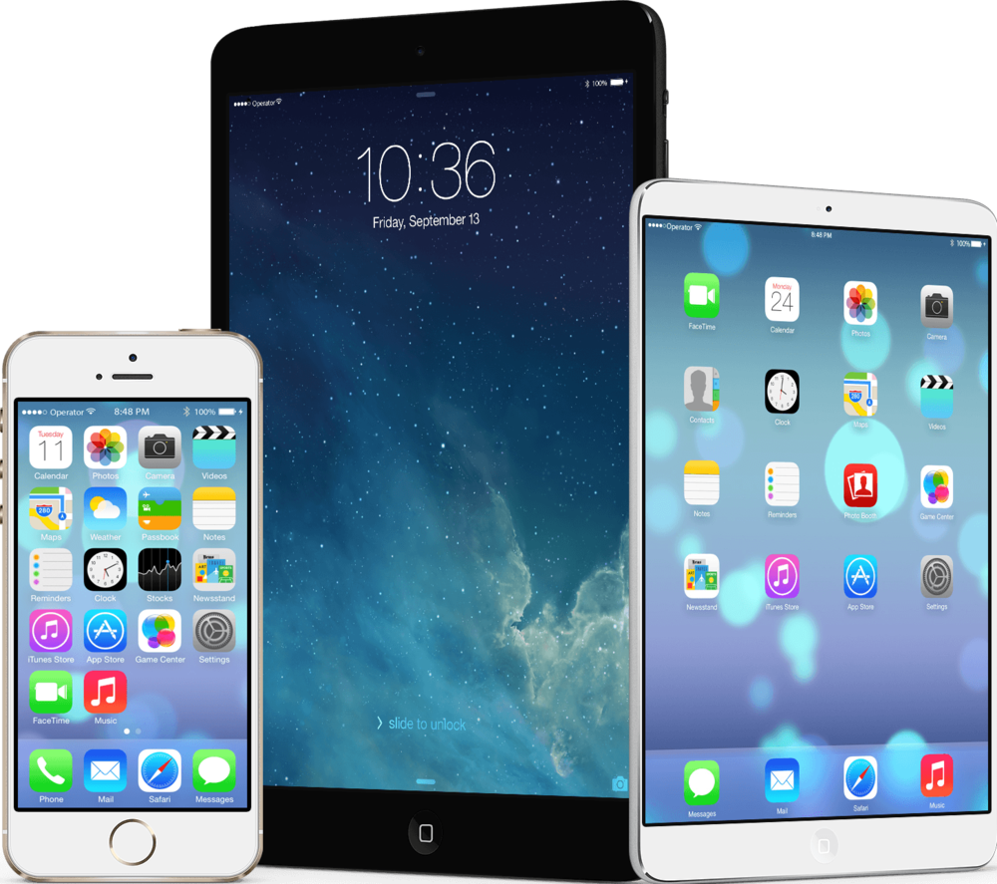

Damages
WPA2 – 60%
WPA, WEP – less secure
A wide scope of potential victims
Design flaw
Threat level: Intermediate as of now
Quite New

Slide 7

Thank You

